Slide 1

ByeByeTruder
Solutie de Securitate a bunurilor

Slide 2


Why?
People want peace of mind. Whether you are at work or on vacation, you need to make sure that what you leave behind is safe and secure.
A theft consists in both financial loss and privacy invasion.
Being robbed and not having a clue about who it was is not cool.

Slide 3


The solution: Surveillance Camera
A simple, free and reliable security camera smartphone application.
A study of 422 burglars found that security cameras were the most effective deterrent to burglars. 60% of the burglars said that they would pick a different target if they knew that a building or site had security cameras, and if they didn’t know ahead of time then 50% said that discovering surveillance cameras would cause them to abort the burglary.

Slide 4

ByeByeTruder
Key Features:
Web browser constantly monitoring video from the camera
Records only the moments when it detects a human
Local storage and firebase cloud storage
Instant notifications with snapshots and face attributes to mobile app
Download records or upload files to firebase cloud storage directly from mobile app
Authorize known people so they don’t trigger false alarms (in development)

Slide 5
How about the competition?
Most apps record continuously. That results in difficulties of finding the actual clip of interest. It also means redundant footage and occupied storage. ByeByeTruder uses AI to save only the clips that contain people.
You can save footage both on local and cloud storage.
3. Notifications with the burglar's traits and a picture with him is sent right away. This
is crucial information in case the footage is lost.

Slide 6
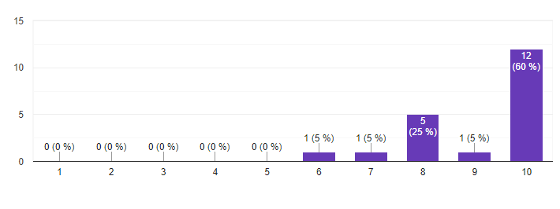
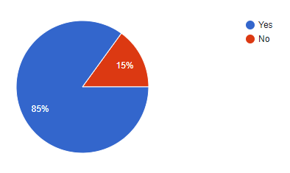
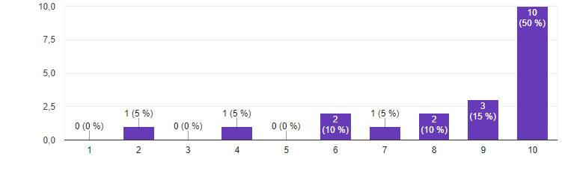
Would you be interested?
What do you think of the idea?
What do you think of the idea?
What do you think of the idea?

Slide 7




Our Team
Stefan Popa Tudor Calafeteanu Bogdan Dobrin Cristian Sandu

Slide 8
Thanks for attention!

